Slide 1

Android
Viewmodels & Themes
Lecture 8
Teacher:
Mahyar T. Moghaddam (mtmo@mmmi.sdu.dk)
Instructors:
Mikkel Nielsen (mini923@student.sdu.dk)
Asta Knudsen (asknu18@student.sdu.dk)

Slide 2
Agenda
Theming
Layout rendering phases
ViewModels
State Management

Slide 3
Theming

Slide 4
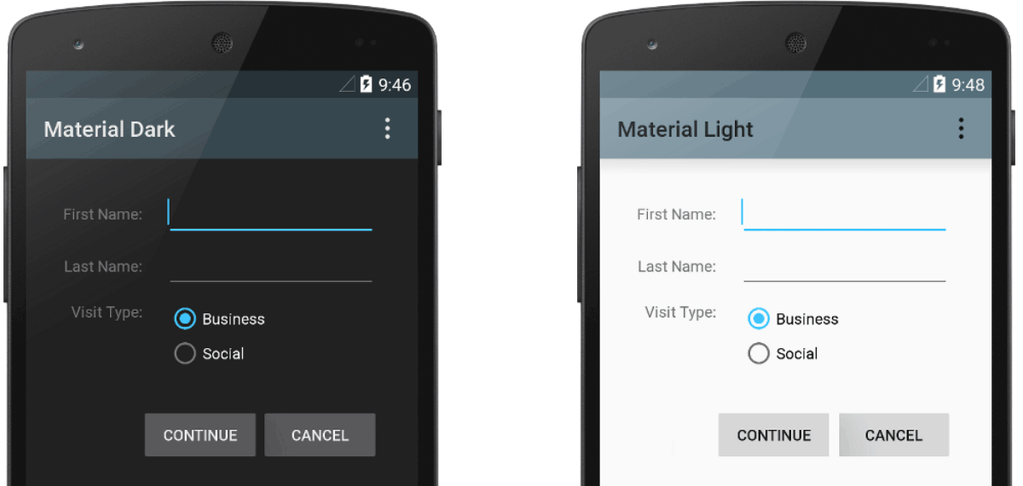
Overview
Definition: Theming is the process of customizing the appearance of your app to enhance user experience and brand identity.
Importance: A well-thought-out theme ensures visual consistency, supports usability, and reinforces brand recognition.
Key Components: Themes typically include color schemes, typography, and UI component styles.
Further reading: Styles and themes

Slide 5

Why now?
Custom themes should be created early in a project
Saving it for later in the process will require a lot of rework
Save yourselves the hassle, and make these considerations as early as possible

Slide 6

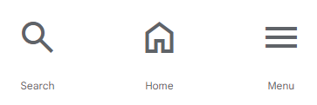
Components of a Theme
Color Palette: Defines the color scheme of your app, including primary, secondary, and accent colors.
Typography: Involves selecting and applying typefaces that enhance readability and aesthetic appeal.
Shapes and Iconography: Determines the shape of UI elements like buttons and cards, and the style of icons used.
Boring App Typography
Cool App Typography
Further reading: Styles and themes

Slide 7
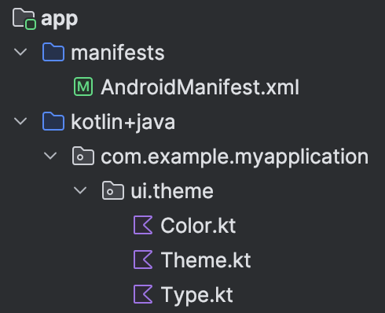
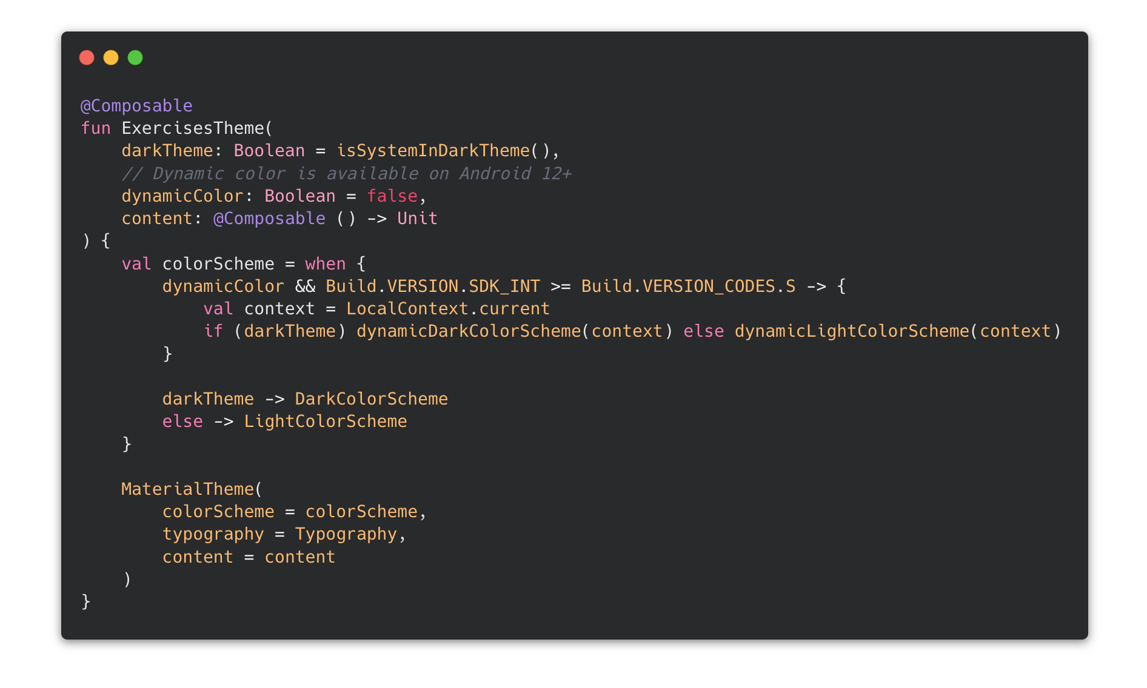
Defining a Custom Theme
In Theme.kt
<AppName>Theme is a composable, which wraps your entire app (at least it should)
Allows screens to access elements from the theme, such as color or font
Recommendation:
  dynamicColor: Boolean = false
  Everything else should be fine as is

Slide 8
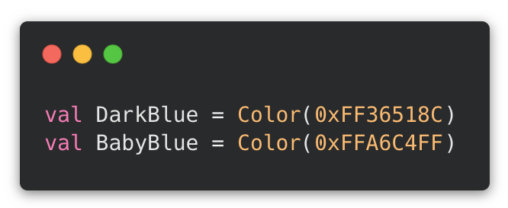
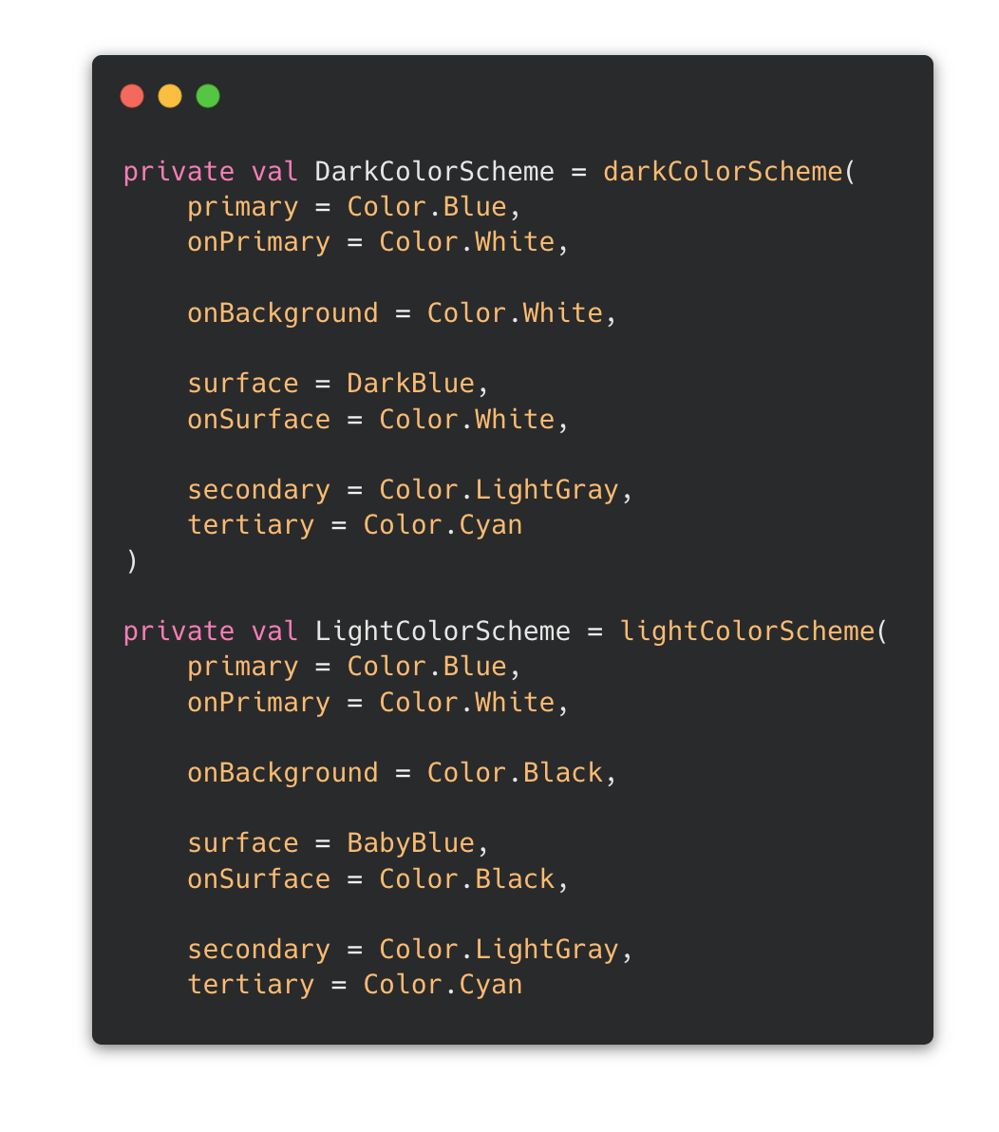
Setting Up a Color Theme
Define your colors in a Color.kt file
  You don’t have to, but good for a custom theme
Apply them in Theme.kt
  DarkColorScheme and LightColorScheme makes it easy to create seperate Dark and Light modes
  Default reusable values such as background, primary, surface, etc.
Further reading: Theming in Compose

Slide 9
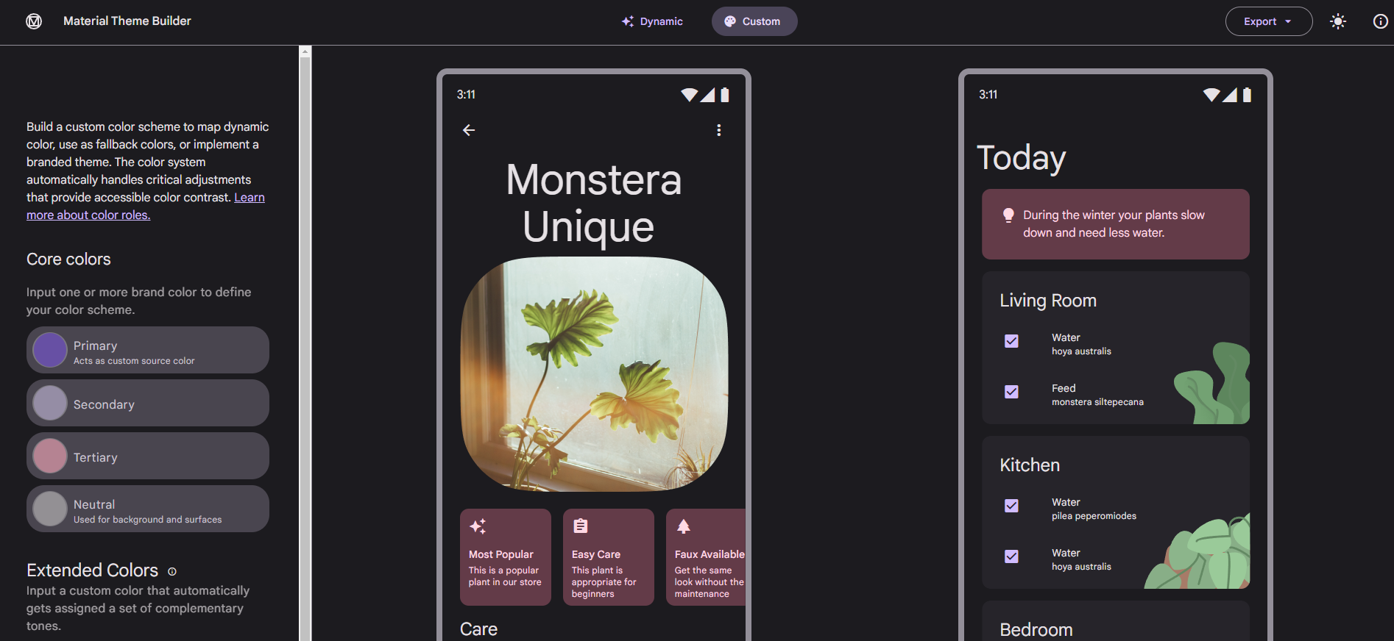
Material Theme Builder
Further reading: Material Theme Builder
Notes:
Visit this site for demostration.

Slide 10
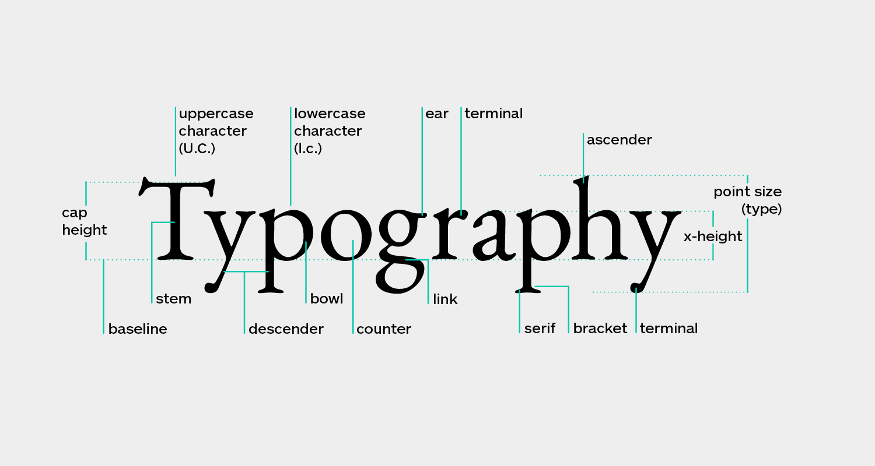
Custom Typography
Good typography enhances the user experience, ensures readability, and maintains a consistent aesthetic across your app.
Jetpack Compose makes it easy to include custom fonts, and setup predefined font styles.
Source
Further reading: Work with fonts

Slide 11
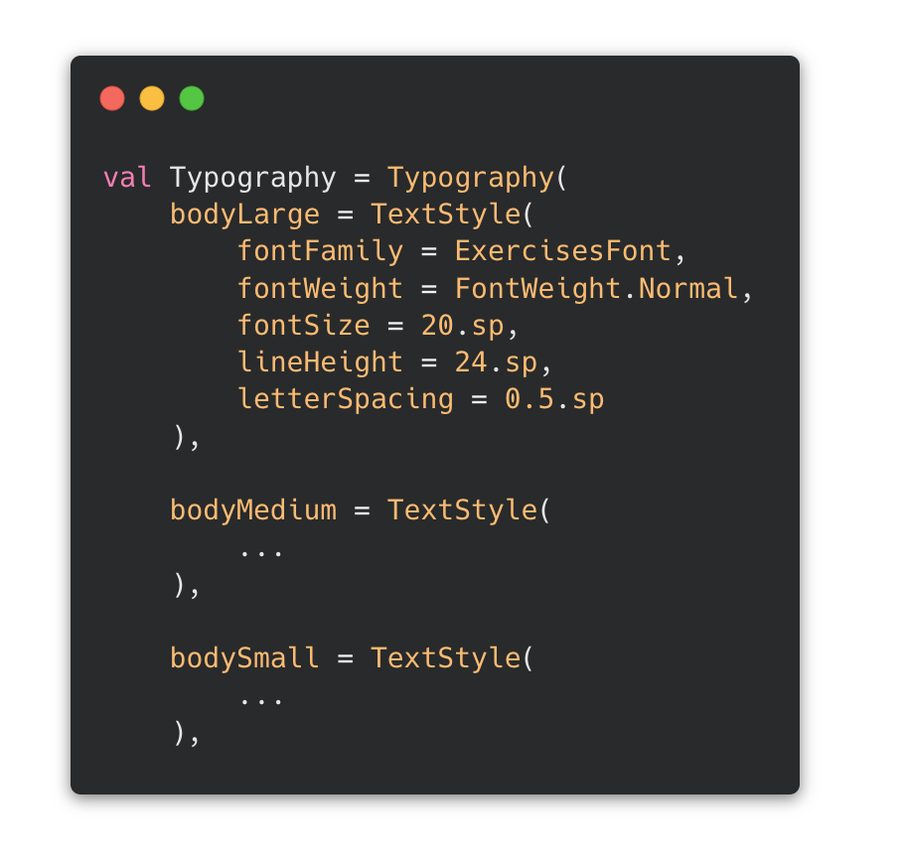
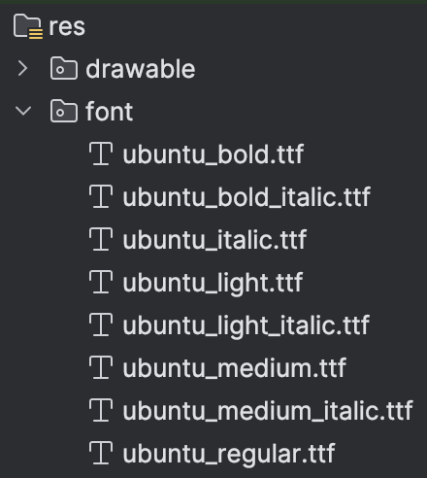
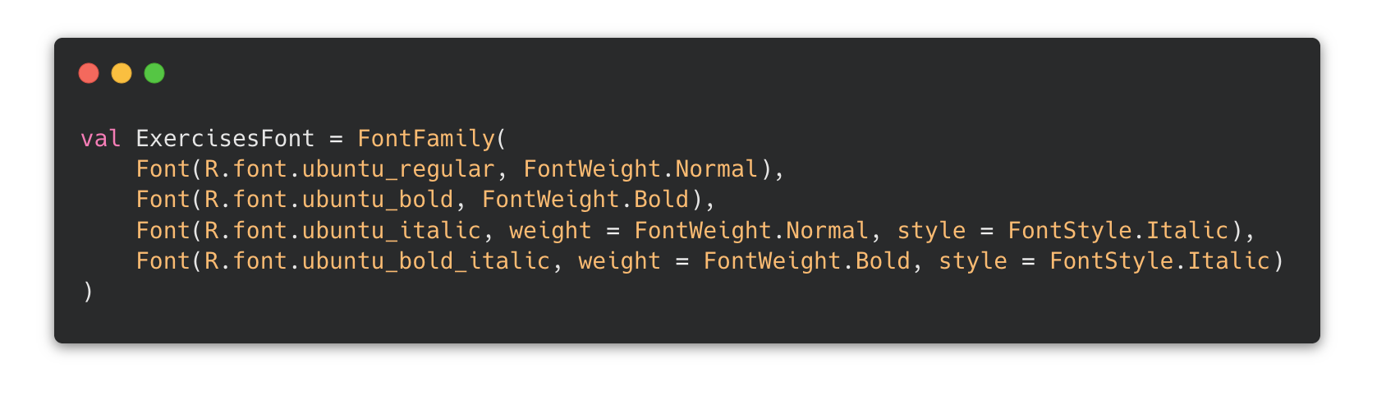
Defining and Using a Custom FontFamily
Fonts can be downloaded using Google Fonts
  Choose a variable font to allow for bold, italic, bold-italic
Font family is defined in Type.kt
Define different reusable text styles for different purposes, such as headers, body, etc.
Further reading: Work with fonts

Slide 12
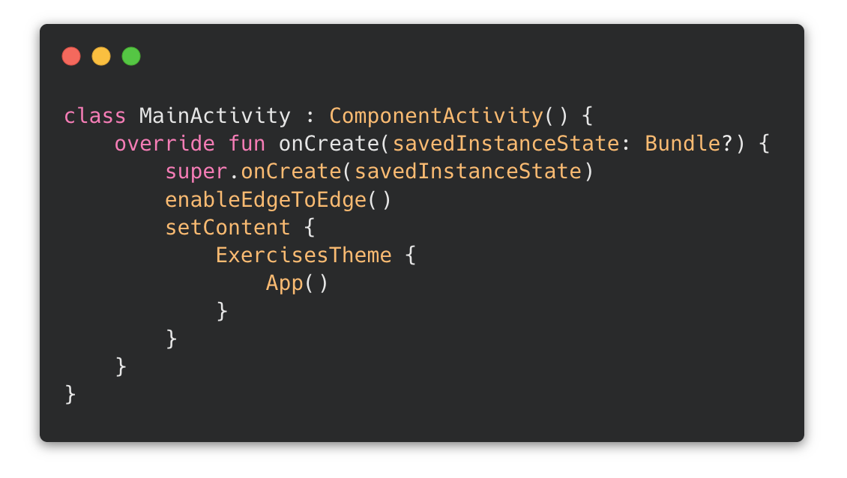
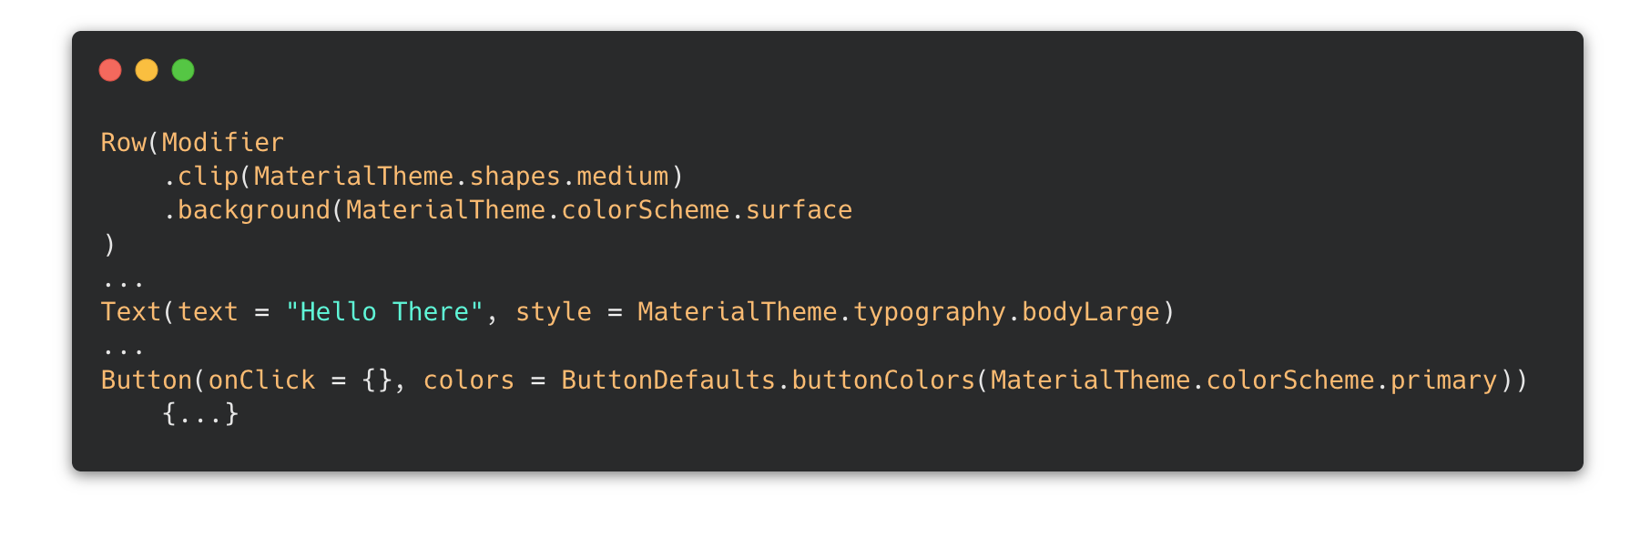
Using the Theme
Wrapping the entire App in the theme allows screens to access its elements
Access elements using MaterialTheme.colorScheme, MaterialTheme.typography, etc.

Slide 13
The MVVM Pattern

Slide 14
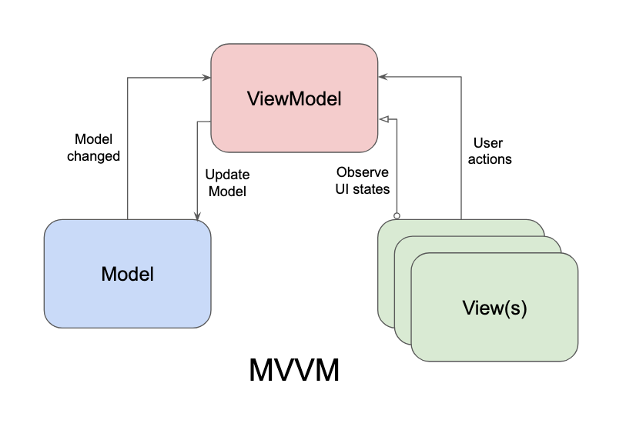
MVVM
Pattern that separates responsibilities into three layers:
  View
  ViewModel
  Model
View
  Displays the UI
  Receives user input
  Contains minimal business logic
ViewModel
  Holds UI state
  Contains presentation logic
  Survives configuration changes
Model
  Data and business logic
  Database
  Repository
This and other architectures are described in a later lecture

Slide 15
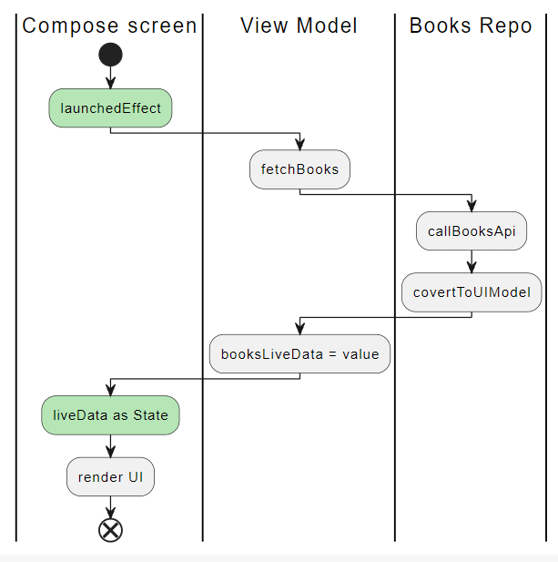
ViewModel - Benefits
Prevents data loss during configuration changes.
Reduces boilerplate code.
Promotes a cleaner architecture by separating data from UI.
Further reading: ViewModel
Source

Slide 16
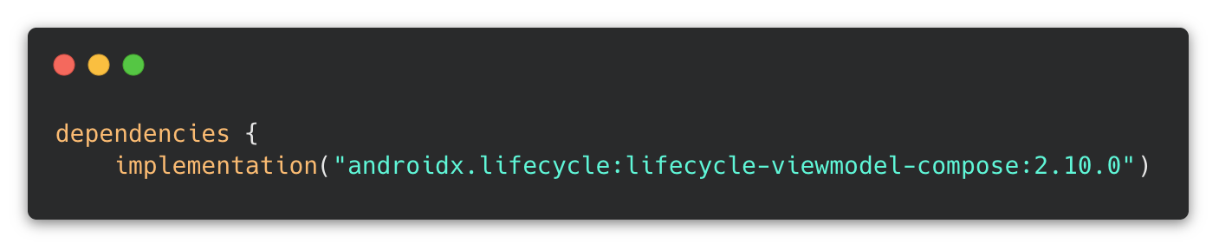
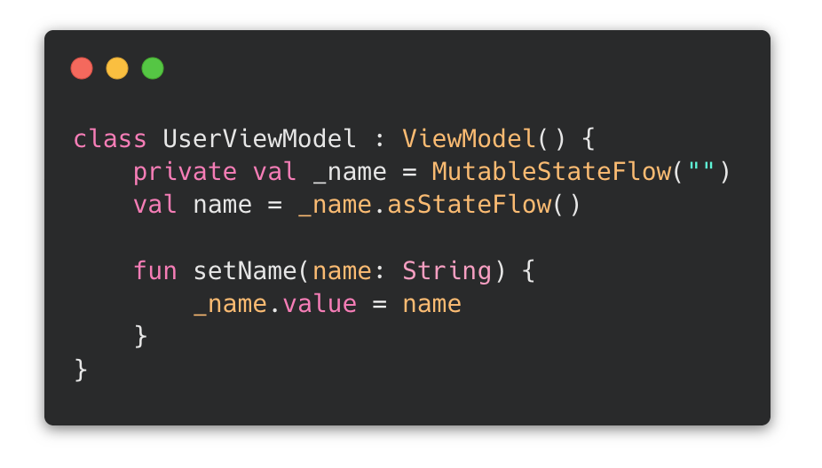
Creating ViewModels
ViewModel for displaying a name
_name is mutable and private
  MutableStateFlow holds a value that can be changed, and sends new value to observers
name is read-only and public
  asStateFlow() creates read-only copy
_name can only be changed using the public function setName()

Slide 17
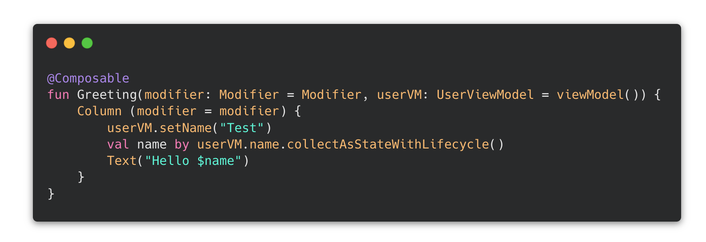
Using ViewModels
ViewModel is passed to the screen that uses it
  = viewModel() means that an instance is created if one is not passed
  If multiple screens use the same VM, the same instance should be passed between them
collectAsStateWithLifeCycle() observes a StateFlow and converts it to Compose State
  In this example, it
  becomes a String that
  can be displayed in
  the UI

Slide 18
State Management

Slide 19
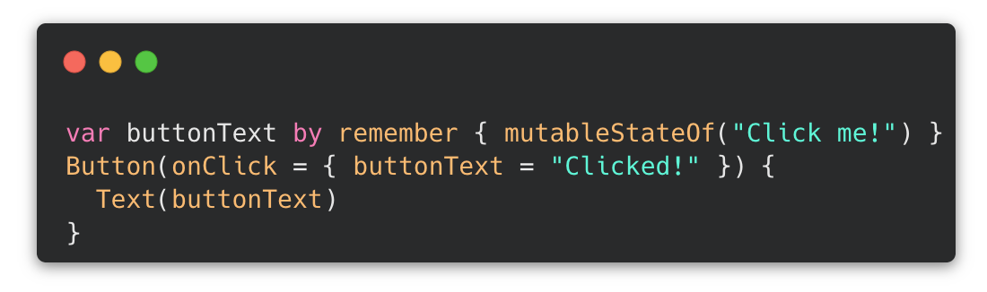
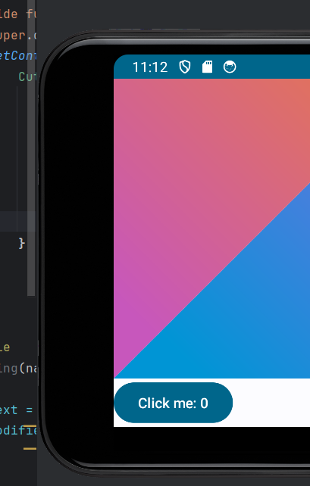
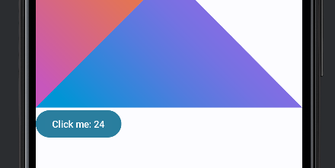
State – continued from last week
Last week we introduced the remember keyword
Allows state to survive recomposition
But...
It is lost if the activity is recreated
  Screen rotation
  Switching to Dark mode
Further reading: State and Jetpack Compose

Slide 20
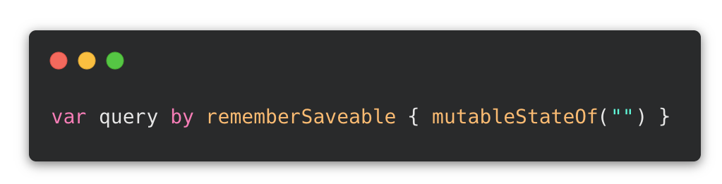
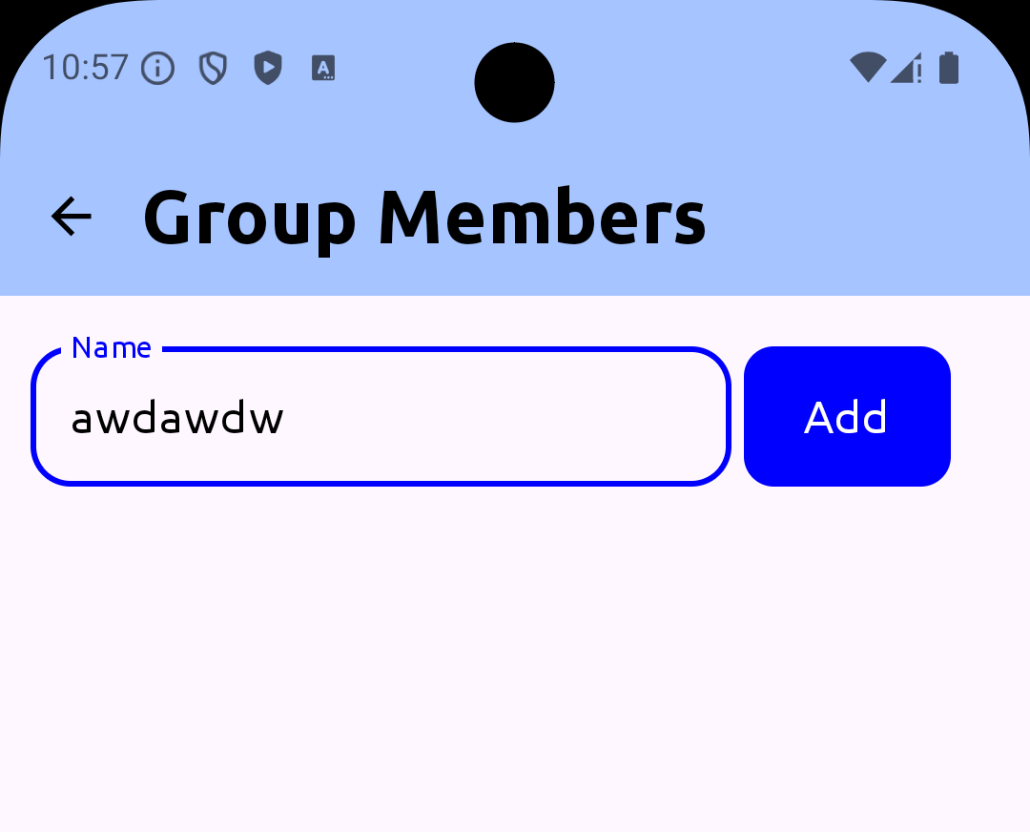
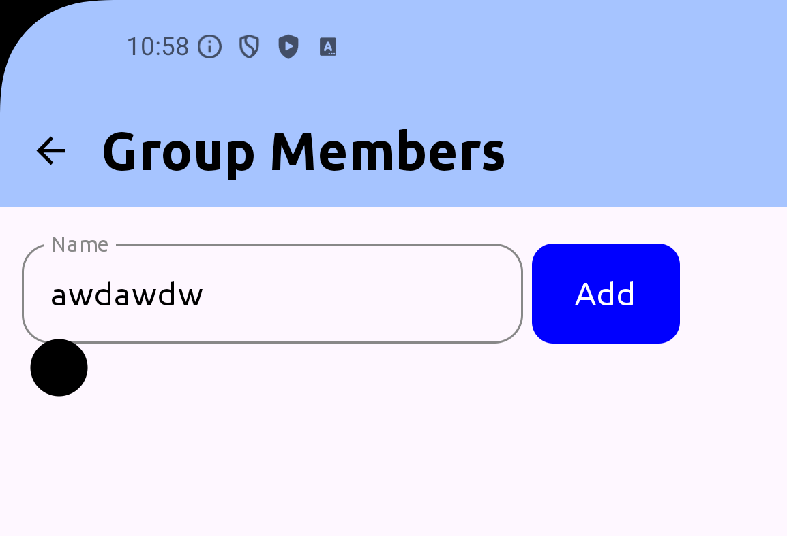
rememberSaveable
The remember function maintains state across recompositions. However, state is lost if the configuration changes
This can be mitigated by using the rememberSaveable function
Rotation
Further reading: RememberSaveable

Slide 21
When should you use which?
remember
Button states
Expanded/collapsed cards
Temporary UI state
rememberSaveable
TextField values
Form input
UI state the user expects to keep

Slide 22
State Management with ViewModels
Centralized state management ViewModels hold and manage state in one place
Shareable across composables Pass ViewModels from parent to child for shared state
Survives configuration changes - State persists across rotations and recreations
Separation of concerns - Business logic stays in ViewModel, UI logic in composables
Further reading: ViewModel

Slide 23
Why ViewModels over remember(Saveable?)
When to use ViewModels
Complex business logic
State shared across multiple screens
Background operations (Networks calls)
State that needs to survive process death
When remember(Saveable) is enough
Simple UI state (toggle, text input)
State only used within a single composable
No business logic involved
Primitive types only
The problem with remember(Saveable) everywhere
Prop drilling nightmare
No separation between UI and potential business logic
Awkward for complex objects
No lifecycle-aware coroutine scope
Further reading: ViewModel

Slide 24
Project work – benchmark your SE-skills
In your groups:
  Create an Android project for your project case
    See Lecture 7: Android 1 on how to create a new project
  Create a lo-fi of a financial group
  Implement the lofi
  Create "add people to group" feature
    Just names
  Ensure added people are not lost after device is rotated
    Remember rememberSaveAble handles state
  Start to make considerations about a theme

Slide 25
Exercise – Use ViewModel instead of rememberSaveable
Now having used rememberSaveable to persist state after recomposition
Design and create a viewmodel that is able to externalize the state

